Slide 1
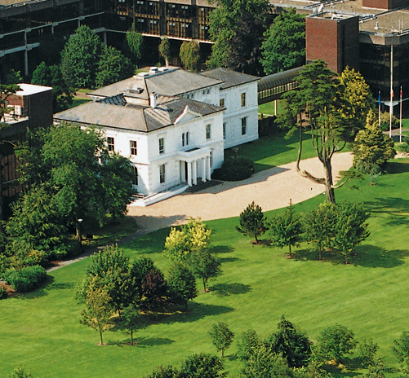


PROJECT MANAGEMENT IN PRACTICE
PRINCE 2
Lecture No: Week: 12
Vispi Shroff
vispi.shroff@ul.ie
Sub Heading
And Date

Slide 2

Today’s Topics & Learning Outcomes
What is PRINCE2 ?
Why PRINCE2 ?
PRINCE2 Methodology
PRINCE2 Process Models

Slide 3
What is PRINCE2?
PRINCE2 – PRojects IN Controlled Environments
It is a process-based method for effective project management.
Extensively used in the UK, particularly by the UK government.
As a result, tends to be widely used in Irish companies.
Originally created in 1989, PRINCE2 came about in 1996 after contributions from 150 European organisations.

Slide 4
Key Features of PRINCE2
The key features of PRINCE2 are:
- Its focus on business justification
- A defined organisation structure for the project management team
- Its product-based planning approach
- Its emphasis on dividing the project into manageable and controllable stages
- Its flexibility to be applied at a level appropriate to the project.

Slide 5
Why PRINCE2?
PRINCE2 provides projects with:
- A controlled and organised start, middle and end
- Regular reviews of progress against plan and against the Business Case flexible decision points
- Automatic management control of any deviations from the plan
- The involvement of management and stakeholders at the right time and place during the project
- Good communication channels between the project, project management, and the rest of the organisation.

Slide 6
PRINCE2 Methodology
PRINCE2 methodology says that a project should have…
- An organised and controlled start, ie. organise and plan things properly before leaping in;
- An organised and controlled middle, ie. when the project has started, make sure it continues to be organised and controlled;
- An organised and controlled end, ie. when you've got what you want and the project has finished, tidy up the loose ends.

Slide 11
Any Thoughts, Questions, Ideas?

Slide 12
Reading Materials for the Week

Slide 13
Conclusions

Slide 14
References

